Slide 1
Ontology Exercise iMinds
Thijs Walcarius and Wim Vandenberghe
October 11th 2013

Slide 2
Situating INDL and NDL-OWL
NDL
NDL-OWL
GEYSERS
NML-WG
INDL
GEYSERS

Slide 3
INDL vs NDL-OWL
Based on the (newer) NML-WG-ontology
Very limited in scope: can only model simple computing elements
Based on the (older) NDL ontology
Very extensive ontology

Slide 4
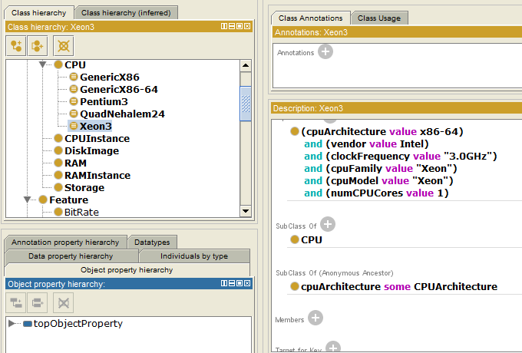
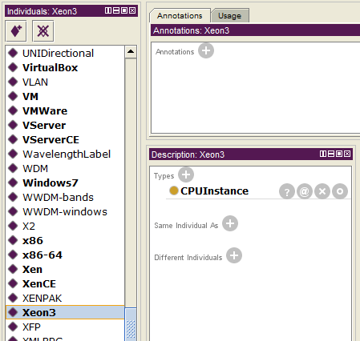
NDL-OWL: problems
Sometimes ambiguous: ex. Xeon3-CPU defined both as class and individual
Doesn’t define units for properties

Slide 5
NDL-OWL: problems
Doesn’t define units for properties explicitly

Slide 6
NDL-OWL: problems
Only suited for representation of 1 type of testbed
No clear representation for (hardware of) network interfaces
Needs to be extended for wireless, sensor networks, etc.

Slide 7
Proposed Solution
Uses latest version of NML: “Network Markup Language Base Schema version 1”
Removes ambigious elements from NDL-OWL

Slide 8
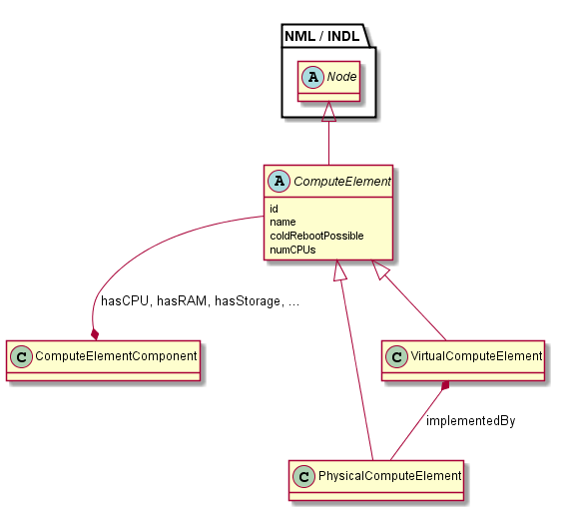
Proposed Solution: Base
Source: compute-draft2.owl

Slide 9
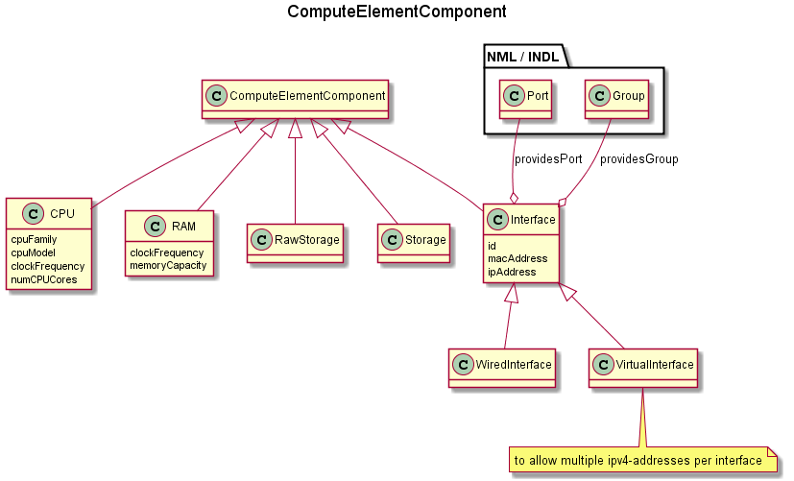
Proposed Solution: Components
Source: compute-draft2.owl

Slide 10
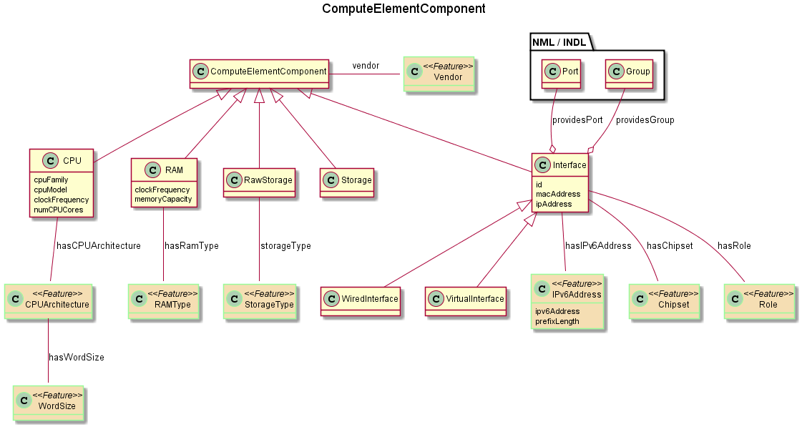
Proposed Solution: Components and Features
Source: compute-draft2.owl

Slide 11
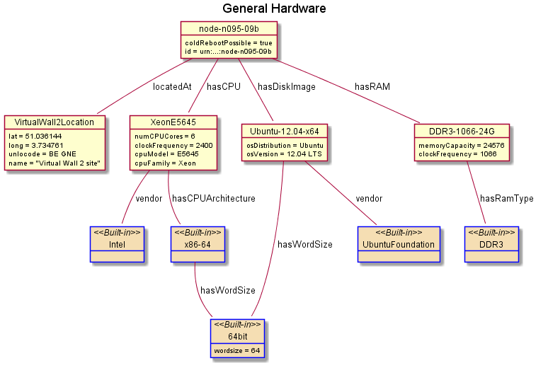
Proposed Solution: Example
Source: virtualwall-draft2.owl

Slide 12
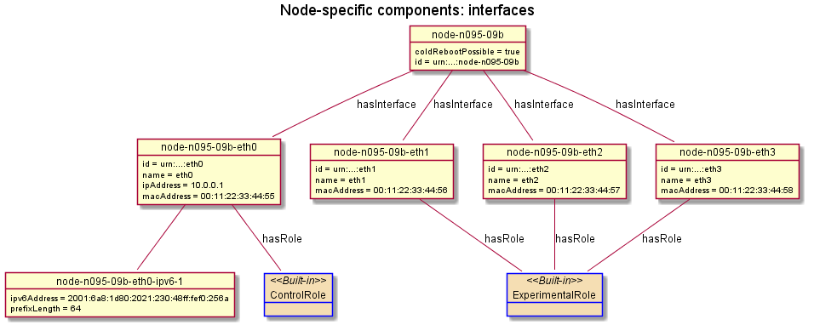
Proposed Solution: Example
Source: virtualwall-draft2.owl

Slide 13
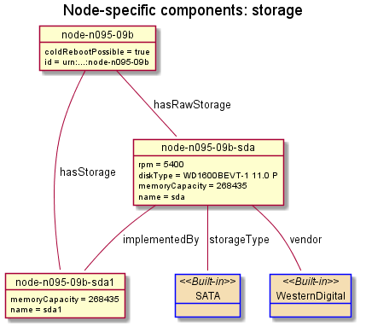
Proposed Solution: Example
Source: virtualwall-draft2.owl

Slide 14
Important question
What is an “individual”?
Ex. Xeon3-CPU
A. 1 individual for all physical instances of a Xeon3-CPU
B. 1 individual = 1 physical instance of a Xeon3-CPU
e.g. 1 individual = the Xeon3-CPU with production-id AB7F58WQ

Slide 15
Important question
What is an “individual”?
No need to distinguish between CPU’s of the same type ➔ 1 individual suffices for 1 type of CPU
Each network interfaces has an unique MAC-address ➔ 1 individual per network interface necessary

Slide 16
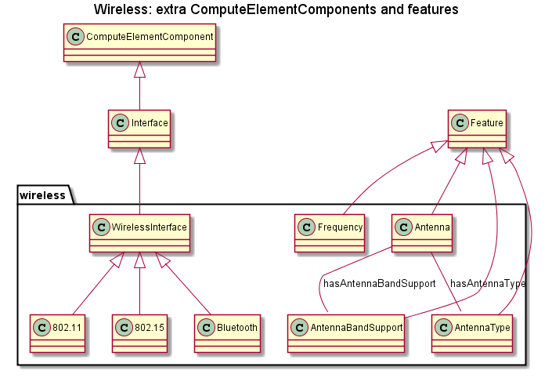
Proposed Solution: Wireless extension
Source: wireless-draft2.owl

Slide 17
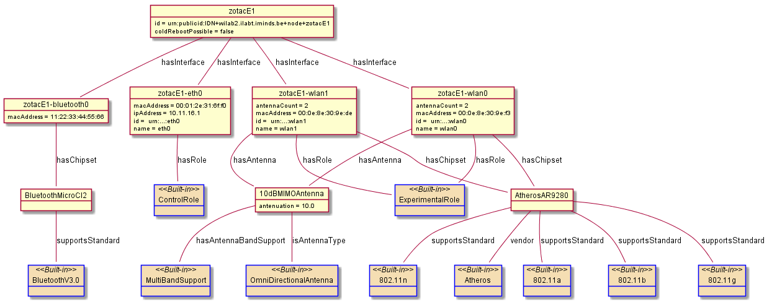
Proposed Solution Wireless: Example
Source: wilab2-draft2.owl

Slide 18
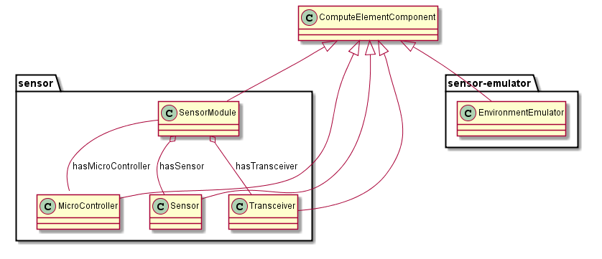
Proposed Solution: Sensor extension
Source: wireless-draft2.owl wireless-emulator-draft2.owl

Slide 19
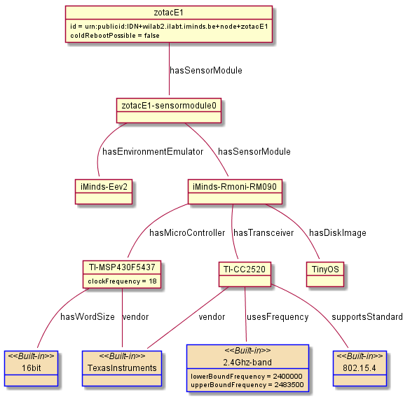
Proposed Solution Sensor: Example
Source: wilab2-draft2.owl

Slide 20
Acknowledgement
This work was carried out with the support of the Fed4FIRE-project (“Federation for FIRE"), an Integrated project funded by the European Commission through the 7th ICT-Framework Programme. (318389). It does not necessarily reflect the views of the European Commission. The European Commission is not liable for any use that may be made of the information contained herein.
Notes:
THIS SLIDE SHOULD ALWAYS BE THE LAST SLIDE OF YOUR PRESENTATION!!!!

